Slide 1
Application of principal component analysis in portfolio management
Group7
Luo zehui, Qichao Li

Slide 2
Dataset

Slide 3
Description of data
ASX200 stock index
Data range 2002/9/24-2021/11/29
66 stocks
3496 trading days
9 fields

Slide 4
The component stocks of the ASX200 index
Industries | Number of stocks
Basic Materials | 10
Consumer Goods | 10
Financials | 22
Health Care | 6
Industrials | 10
Oil & Gas | 4
Technology | 2
Telecommunicationss | 1
Utilities | 1

Slide 5
Choose number of components

Slide 6
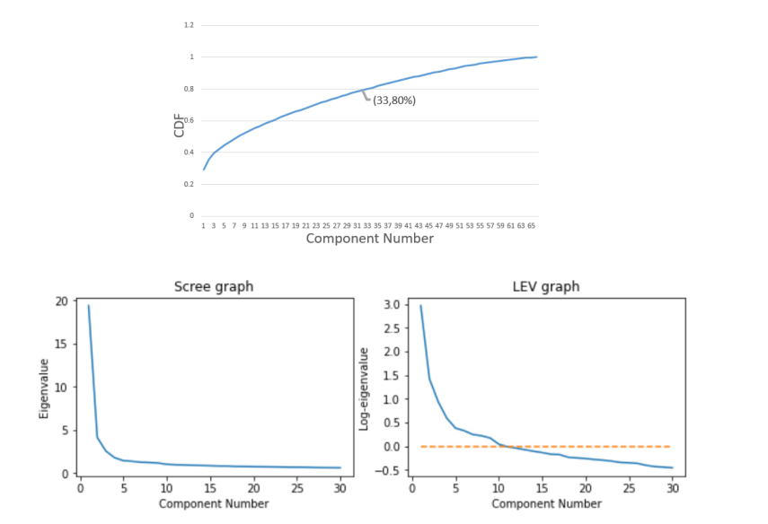
Cumulative Variance

Slide 7
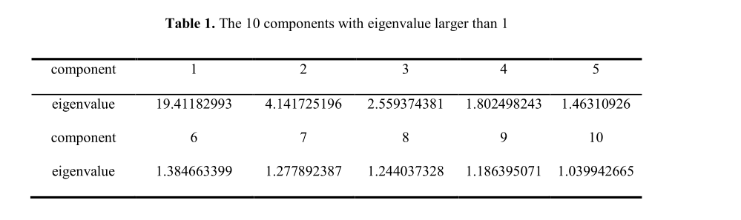
Kaiser’s rule
According to the above three strategies, we should retain 10 components.

Slide 8
Eigenvectors of 10 components

Slide 9
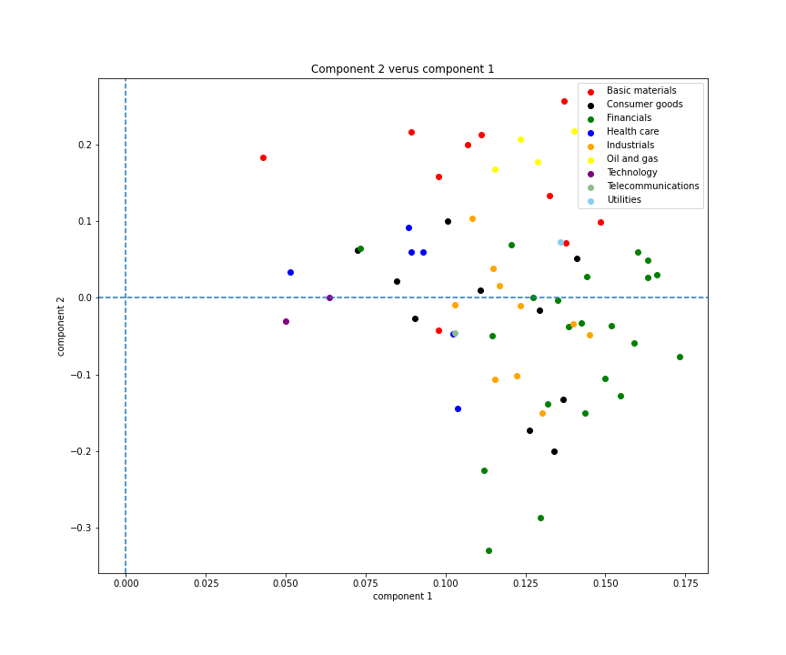
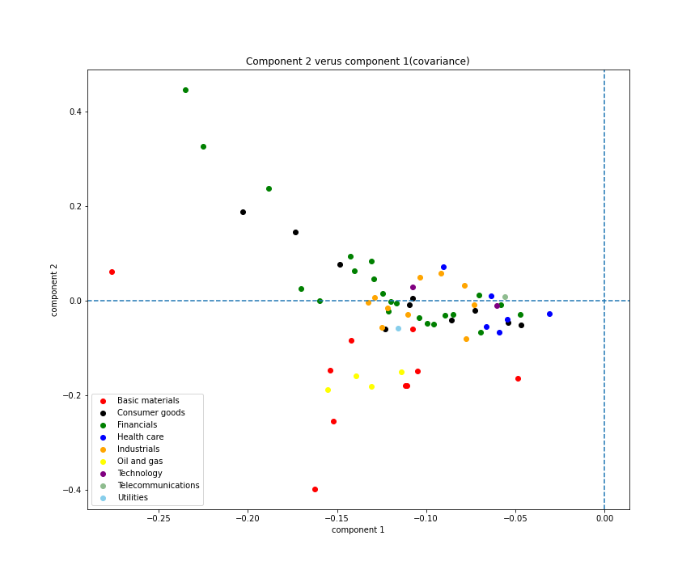
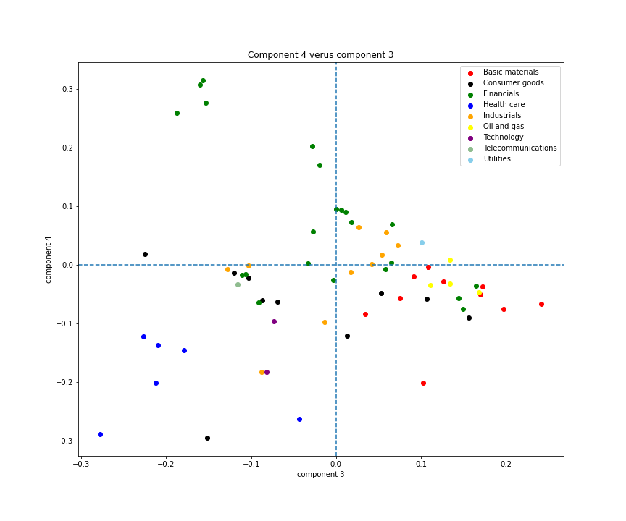
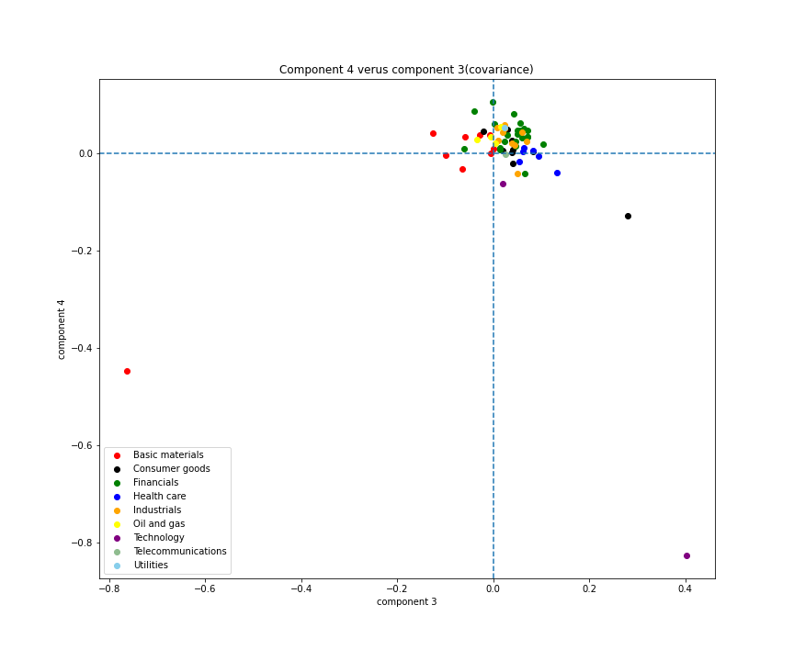
Correlation
Covariance

Slide 10
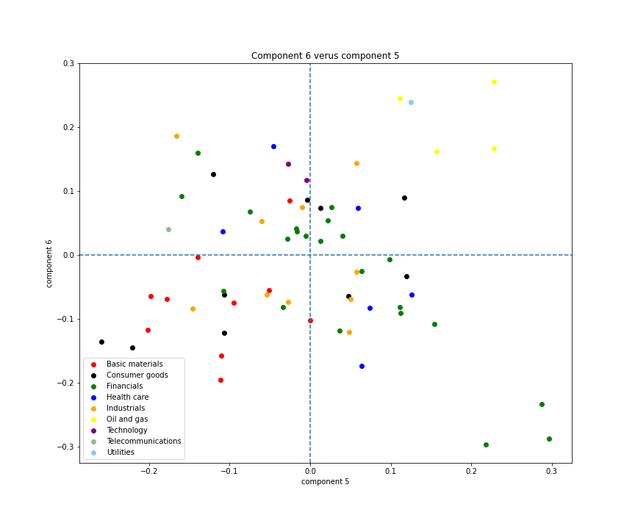
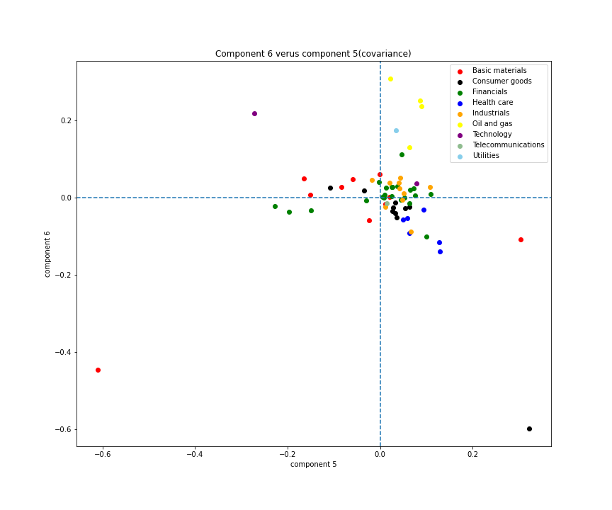
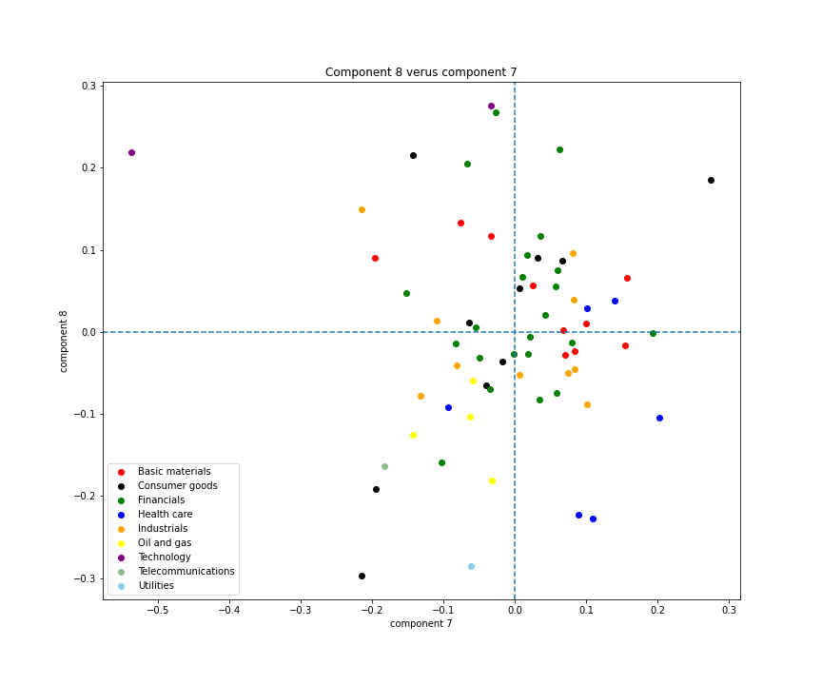
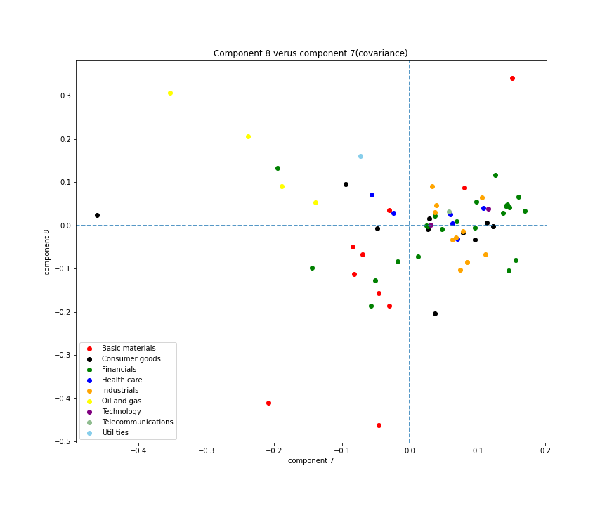
Correlation
Covariance

Slide 11
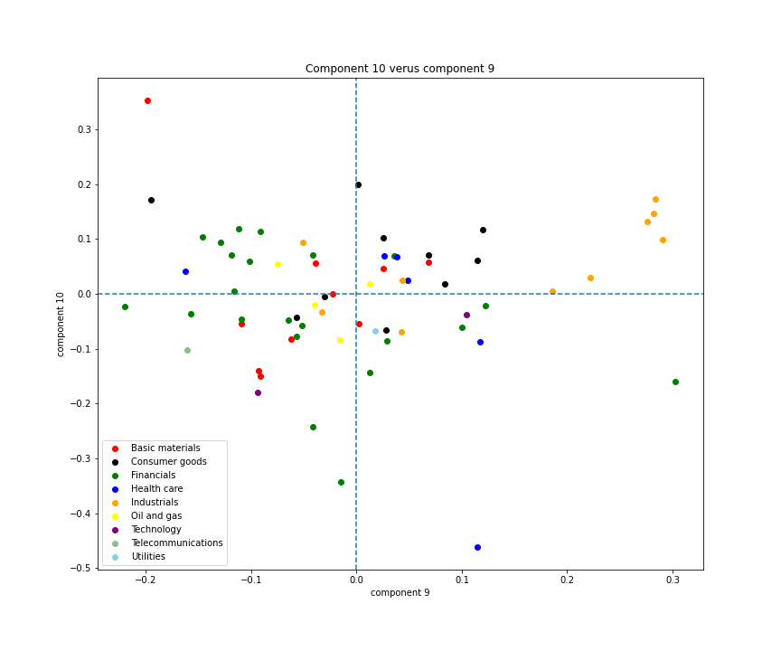
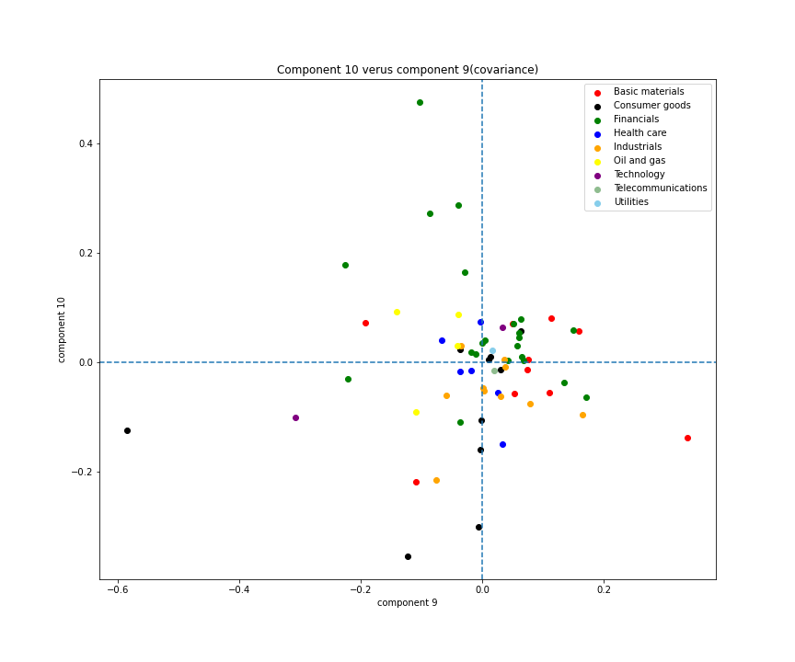
Correlation
Covariance
We can find correlation is better than covariance, as the figures of components calculated by correlation matrix are more divergent.

Slide 12
Plots of principal portfolios

Slide 13
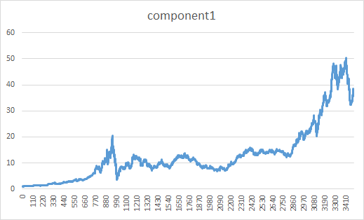
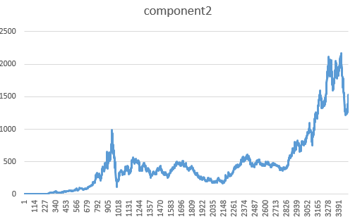
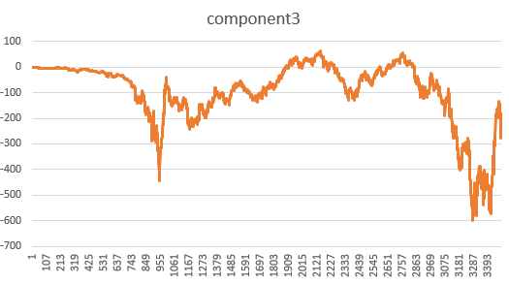
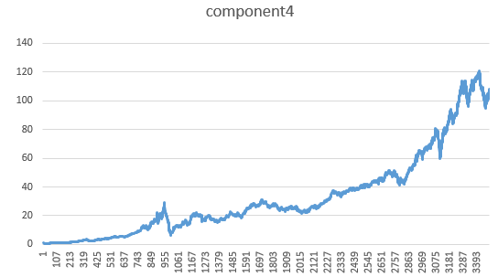

Slide 14
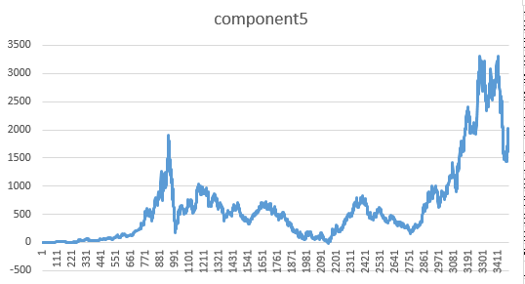
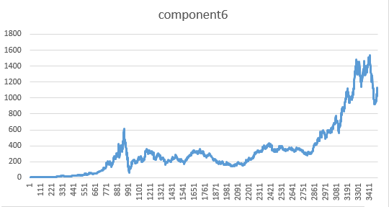
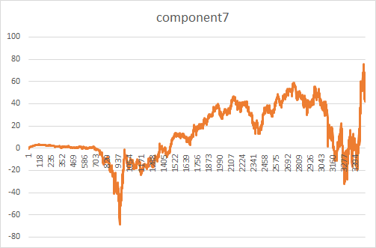
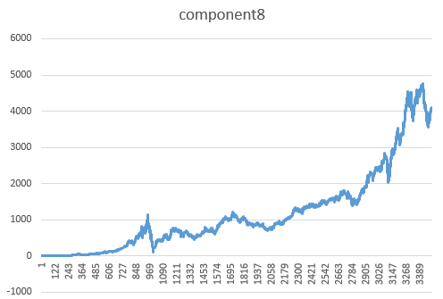

Slide 15
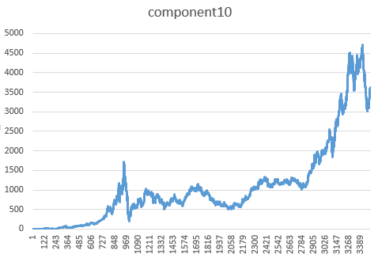
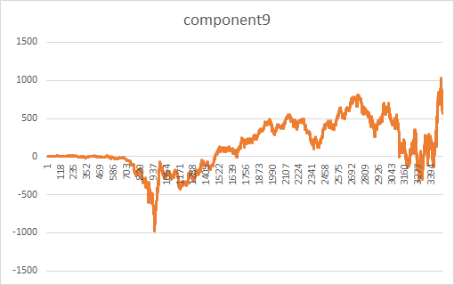
We can find that the portfolios generated by component3, component7, and component9 are relatively opposite trends from the others.

Slide 16
The performance of different portfolios

Slide 17
1/N—stocks (EWS)
Risk Parity—stocks (RE)
1/N—principals (EWP)
Risk Parity—principals (DRP)

Slide 18
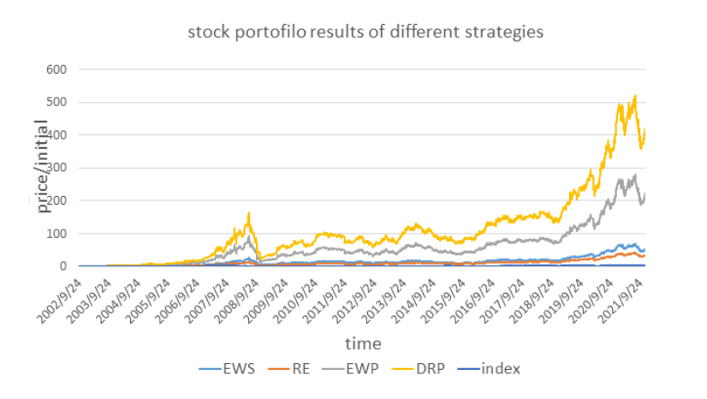

Slide 19
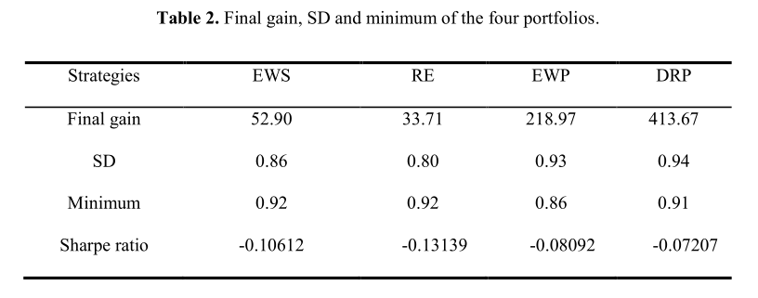
The holding time is too long, which makes the Sharpe ratio to be less than 0 for all the strategies

Slide 20
THANK YOU!

